Slide 1

NoteX

Slide 2
NoteX

Slide 3
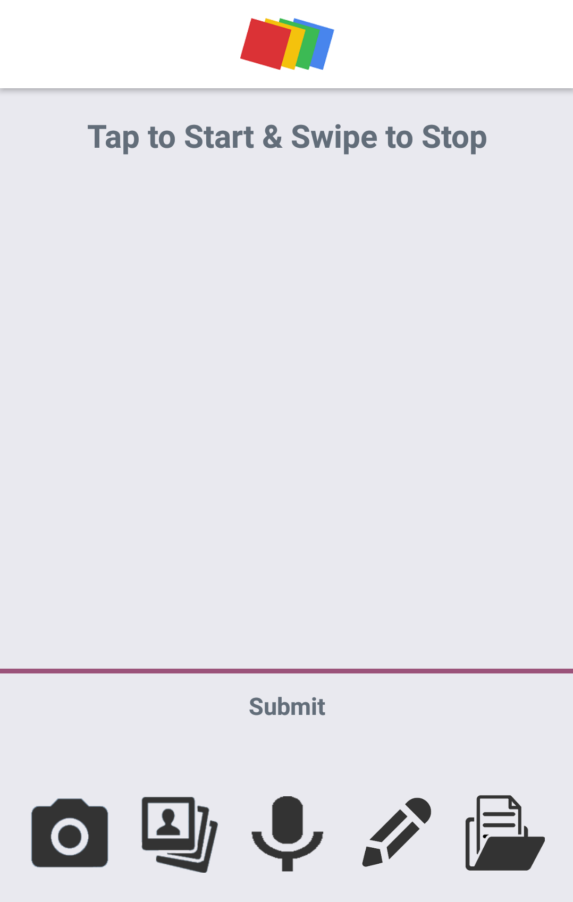

Slide 4
Camera
Take a photo to convert handwriting to text

Slide 5
Camera
Take a photo to convert handwriting to text

Slide 7
Gallery
Choose existing photo to convert handwriting to text

Slide 8
Gallery
Choose existing photo to convert handwriting to text

Slide 10
Voice
Speech-To-Text in various languages

Slide 11
Voice
Speech-To-Text in various languages

Slide 13
Sketch
Draw and save sketches in your camera roll

Slide 14
Sketch
Draw and save sketches in your camera roll

Slide 16
Note storage
View, edit, delete existing notes

Slide 17
Note storage
View, edit, delete existing notes

Slide 19
Tap to type a new note

Slide 20
Tap to type a new note

Slide 21


Slide 22
Swipe when you’re done
Tap to Submit

Slide 23
Swipe when you’re done
Tap to Submit

Slide 24
Enjoy using NoteX

Slide 25
Enjoy using NoteX

